Slide 1
Module 6 – Topic 2
Strategist – Expert level
Topic 2: Erasmus+ Accreditations / Erasmus plan

Slide 2
Erasmus Plan
2.1 Definition
2.2 Structure of the Erasmus Plan
2.3 How to write a good Erasmus Plan

Slide 3
2.1 Definition
An “Erasmus Plan” is a road map linking mobility activities with your organisation’s needs and objectives.
Mobilities activities should be an integral part of the general development plan of your organisation, not only an ”add-on”.
In other words, by organising mobility activities your organisation should also work on broader development goals.

Slide 4
The Erasmus plan sets out how you plan to organise mobility activities and what your organisation aims to achieve by implementing these activities.
As stated in the Application form, when preparing the Erasmus Plan you should answer to one key question: how are you going to use the Programme’s Key Action 1 funding to benefit your organisation and all of its staff and learners, whether they take part in mobility activities or not.
You should be able to address this question explaining in a holistic way how the funding that you will receive will support the development of your organisation and the personal development of students and staff.

Slide 5
NOTE
If the Internationalisation Strategy is the strategic document, the Erasmus plan is the backbone of the accreditation application, namely the operational programme that the organisation decides to implement concerning mobility activities.
While the strategy should describe your plans for implementation of cooperation and networking projects at international level in the medium-long term (next 5 years), the plan should explain how the organisation of mobility activities will be a part of this strategy.
An Erasmus Plan contributes to achieve the goals outlined in the "Internationalisation Strategy".

Slide 6
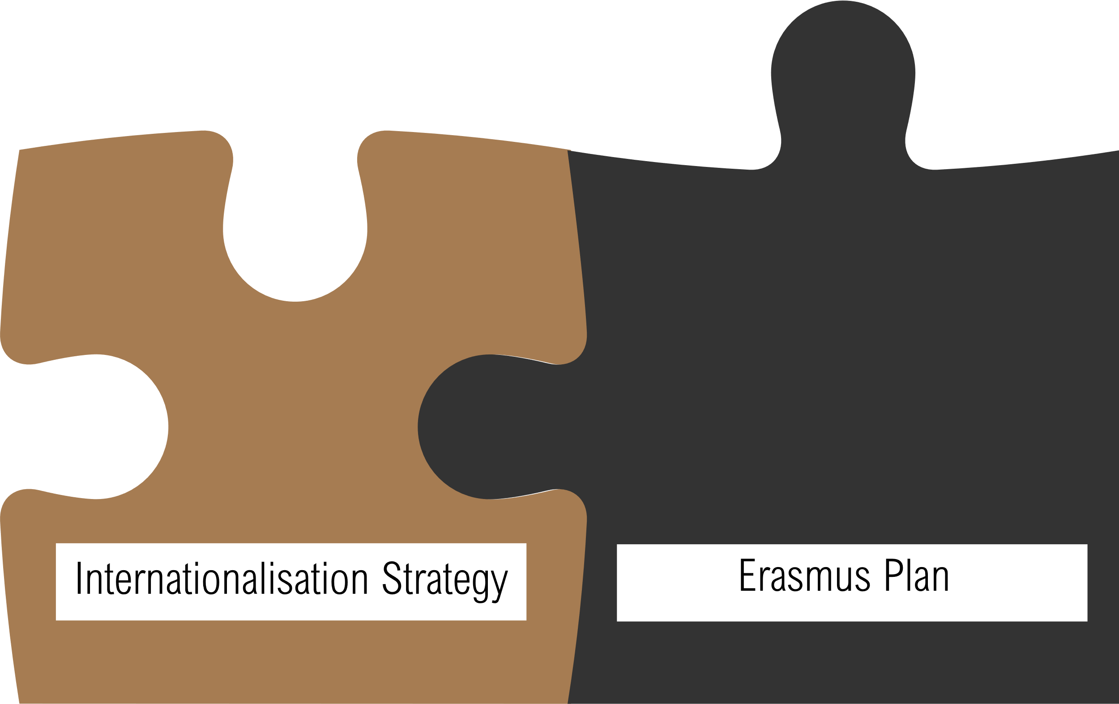
Like 2 puzzle pieces

Slide 7
2.2 Structure of the Erasmus Plan
The application form provides you with a specific frame to build your Erasmus Plan.
The Erasmus Plan is composed of three parts:
objectives, activities and planning for management and resources.

Slide 8
Structure of the Erasmus Plan: Objectives
The objectives the organisation wants to achieve by implementing programme activities.
These should be clear and realistic, possible to track and evaluate.
The objectives must be linked to the needs of the organisation, with a concreate benefit for it.
Concretely, there can be between one and ten objectives.

Slide 9
Structure of the Erasmus Plan: Activities
The activities your organisation would organise and participants you want to support with programme funding.

Slide 10
Structure of the Erasmus Plan: Management & Resources
Explain how you will organise the work so that the quality standards are met.

Slide 11
2.2 Structure of the Erasmus Plan: TOP TIPS
Check what you need to do before you fill in the application form
Create a “to do list” with all the activities that must be done to apply as soon as possible
Start your application well before the application deadline in order to have enough time to prepare and submit your application

Slide 12
2.2 Structure of the Erasmus Plan: more TOP TIPS
Get familiar with the application jargon by reading the guidelines and the glossary
Speak with other organisations who have already submitted (and/or obtained) the accreditation to get their insights and advice. You will find organisations willing to help you
Look out for webinars run by the National Agency

Slide 13
2.2 Structure of the Erasmus Plan: more and more TOP TIPS
The Erasmus Plan must be original and tailored on your organisation needs, experience, ambitions and resources
The application must be coherent in all its part (the evaluator will read the application, the International Strategy and the Erasmus plan. All elements must match)
Work in team involving as many colleagues as possible while drawing the application
Even if you are not 100% sure you are ready to get the Accreditation try to apply for it. You will learn from your first attempt and if you are unsuccessful you can review your application and improve it

